Slide 1

Week #1
Operations Research
(Software Engineering)

Slide 2
Lets start with a Mapping as an organization’s Prospective
Profit Maximize
Cost Minimize
Resources Optimize
Input
Output

Slide 3
Operation Research
Operations Research is an Art and Science
Operation Research (O.R) is an art of wining wars without actual fighting. (Arthur Clark)
O.R is a scientific approach to the problems (H.M. Wagner)

Slide 4
Operation Research
O.R is a scientific approach towards linear programming problems
O.R in one sentence is defined as “Do things best under constraint”

Slide 5
Brief Introduction
O.R is the act of getting the best outcome. The basic goal is to maximize benefit, minimize effort, minimize risk and minimize cost. The benefit, effort, cost and risk are normally expressed by a function of certain design variables.
O.R is the procedure of finding the conditions which give the minimum and maximum value of a function.

Slide 6
Brief Introduction
O.R Models have been used for a long time, now adays they have become essential as business and work related to engineering becomes difficult and more complicated. Therefore it is no feasible economically to make the decision without the assistance of such models.
For example in a big firm a minor improvement in the percentage might lead to a million dollar increase in profit

Slide 7
Brief Introduction
But for achieving this improvement might require proper analyzing of all sections of a firm, which is possible with the help of O.R Models.
After the rapid development of efficient and high-speed computers this field gets great attention, more and more problem have been explored and solved.
The field of O.R is still a very active research area.

Slide 8
Background
The roots of O.R are as old as science and society. Though the roots of O.R extends to even early 1800, it was in World War II, when Frederick W. Taylor emphasized the application of scientific analysis to the methods of production, that the real start took place.

Slide 9
Application of O.R in real life/Scope
O.R is applied to a lot of real world cases, some of them are given below.
Assignment (assigning uber drivers to customer.
Scheduling (scheduling multiple TV shows together to achieve max views possible).
Pricing Science (airline ticket pricing).

Slide 10
Application of O.R in real life/Scope
4. Routing (master planning the routes of
buses, so that few buses are needed as
possible).
5. Facility location (deciding the most
appropriate location for new facility such
as warehouse , factory or fire station).

Slide 11
Application of O.R in real life/Scope
For example you want to travel from Islamabad to Lahore, then you will open google map, it provides you option like car, trains, buses and flight (these are the available resources) and you will decide which resources suits you.

Slide 12
When is oR USED?
O.R is a way to solve problems in which one seeks to achieve the best outcome.
Simulation allows you to try out different approaches by simulating events numerous times and answer the “What if…?” question.
Queuing theory is used to approximate a real queuing situation or system, so the queuing behaviour can be analysed mathematically.

Slide 13
WHEN IS OR USEFUL
When a decision is complex or it’s unclear what the main problem is
When it’s uncertain what the outcome of different actions will be
When you don’t know how well things are working or think they could work better
When you are worried about risks
When you need to take account of the views of different stakeholder groups

Slide 14
Terminology
The British/Europeans refer to “Operational Research", the Americans to “Operations Research" - but both are often shortened to just "OR".

Slide 15
O.r models
The most common used model of O.R is Linear Programming, whereas the other used models of O.R is given below,
• Network Optimization
• Integer Programming
• Nonlinear Programming
Inventory Models

Slide 16
OR Process:
Observation
Problem Definition
OR Techniques
Model Construction
Solution
Feedback
Implementation
Information

Slide 17
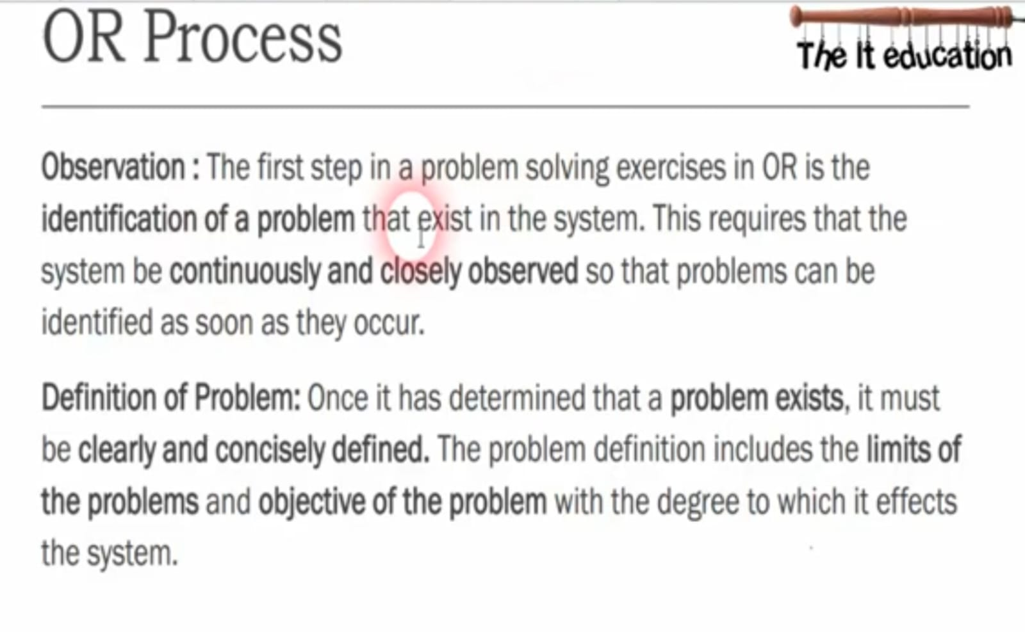

Slide 18
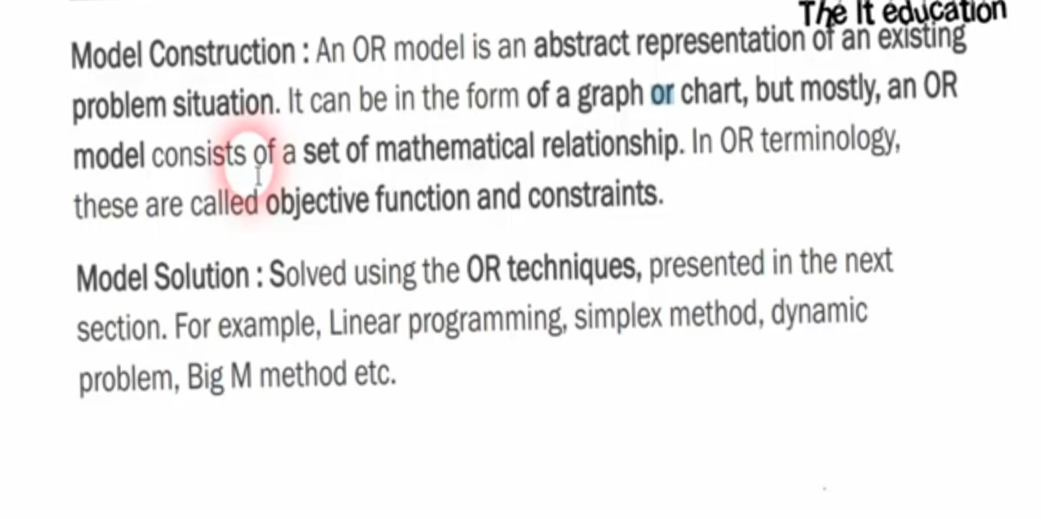

Slide 19
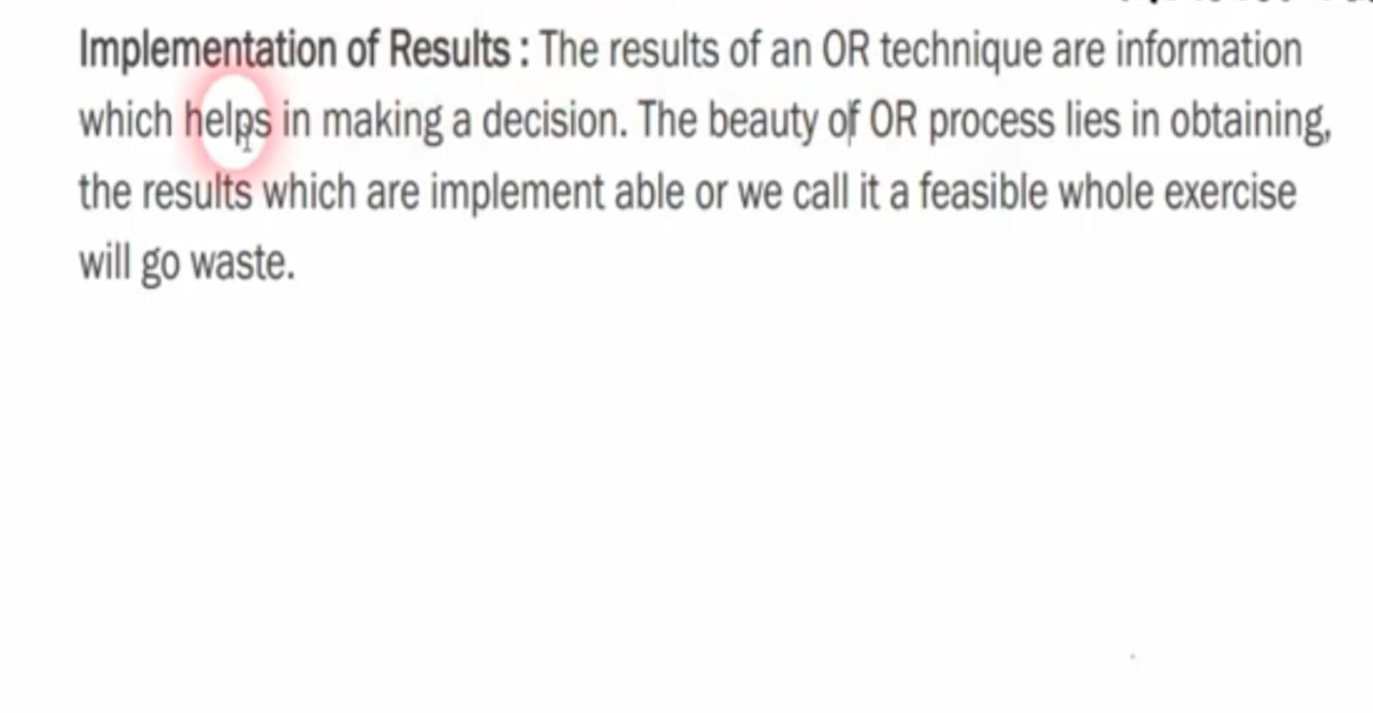

Slide 20
Linear programming
The term Linear programming is the combination of two terms “Linear” and “Programing”. The term linear stands for indicating the relationships between different variables of degree one and the term programming refers to the process determining particular program or plan of action.

Slide 21
Linear programming
Linear programming is a model of choosing the best alternatives from the set of feasible alternatives, in such a situation in which the objective function as well the constraints can be expressed as linear mathematical function. The linear function which is to be optimized is called the objective function. Thus linear programming is a mathematical technique for allocating limited resources in optimum manner.

Slide 22

Linear Function
linear function contains terms of which is composed of a variable raised to the power one. Linear functions are those whose graph is a straight line.
e.g. 3x+2y = 7 (linear)
3$x^{2/3}$+2y = 7 (Non-linear)

Slide 23

Objective Function
z = $x_{1}{+x}_{2}$ is the most typical form of objective functions are maximize f(x) or minimize f(x).
In other words that function whose work is to maximize or minimize the linear function is called objective function.

Slide 24
constraint
The restrictions or limitations on any linear function is called constraint.
The mathematical forms of constraints are f(x) ≤ b or f(x) ≥ b or f(x) = b

Slide 25

Feasible solution
A set of real values of X=($x_{1}, x_{2}, …. x_{n}$), which satisfies the constraint AX ≤ b or AX ≥ b or AX = b and satisfies the non-negativity restriction X ≥ 0 is called feasible solution

Slide 26
optimal solution
The solution where the objective function is maximize or minimize is known as optimal solution

Slide 27
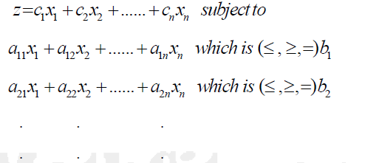

General linear programming
$$x_{1}, x_{2}, ….., x_{n} ≥0.$$

Slide 28
Formulation of linear programming in mathematical form
A company manufactures two products A and B. Both products are processed on two machines M1 and M2.
Profit per unit of A is Rs=100 and for B is Rs=80. Find out the monthly production of A and B to maximize profit.
Products | M1 (Resource) | M2 (Resource)
A | 6 hrs/Unit | 2 hrs/Unit
B | 4 hrs/Unit | 4 hrs/Unit
Availability | 7200 hrs/Unit | 4000 hrs/Unit

Slide 29
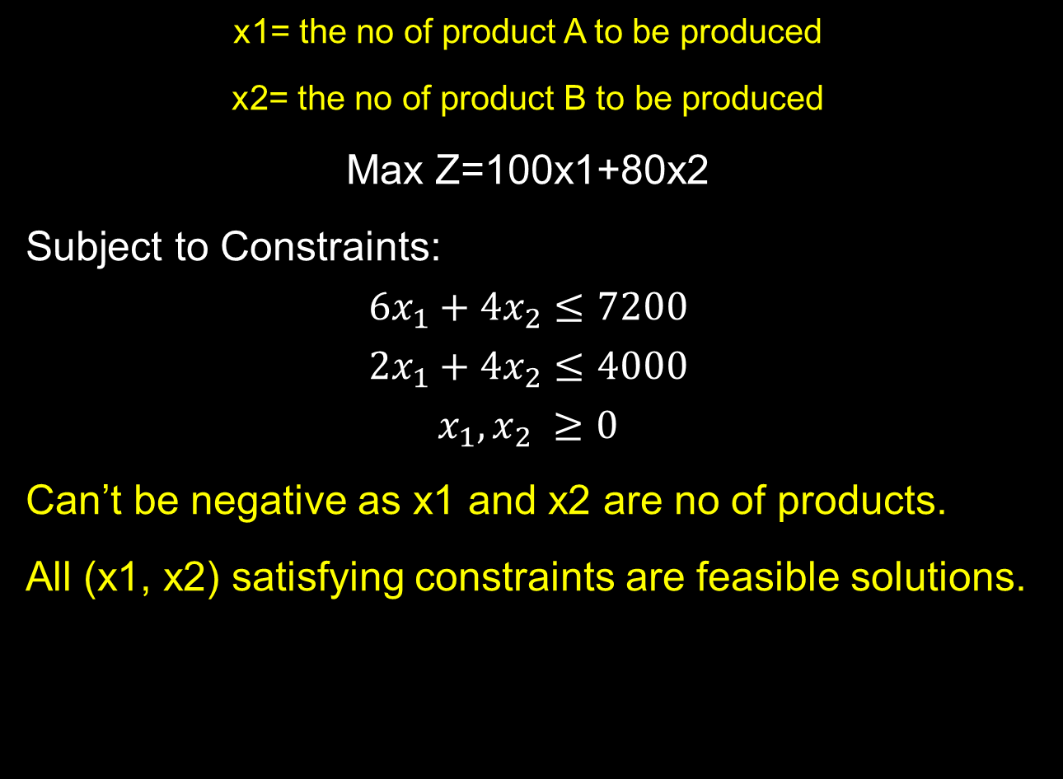
Formulation of linear programming in mathematical form
x1= the no of product A to be produced
x2= the no of product B to be produced
Max Z=100x1+80x2
Subject to Constraints:
$$6x_{1}+4x_{2}≤7200$$
$$2x_{1}+4x_{2}≤4000$$
$$x_{1},x_{2} ≥0$$
Can’t be negative as x1 and x2 are no of products.
All (x1, x2) satisfying constraints are feasible solutions.

Slide 30
Formulation of linear programming in mathematical form
A factory manufactures two products A and B. To manufacture one unit of A 1.5 machine hours and 2.5 labor hours are required. To manufacture product B 2.5 machine hours and 1.5 labor hours are required. In a month 300 machine hours and 240 labor hour are available.
Profit per unit of A is Rs=50 and for B is Rs=40. Formulate as linear Programming.

Slide 31
Formulation of linear programming in mathematical form
Products | Machine hours | Labour Hours
A | 1.5 | 2.5
B | 2.5 | 1.5
Availability | 300 hours | 240 hours

Slide 32
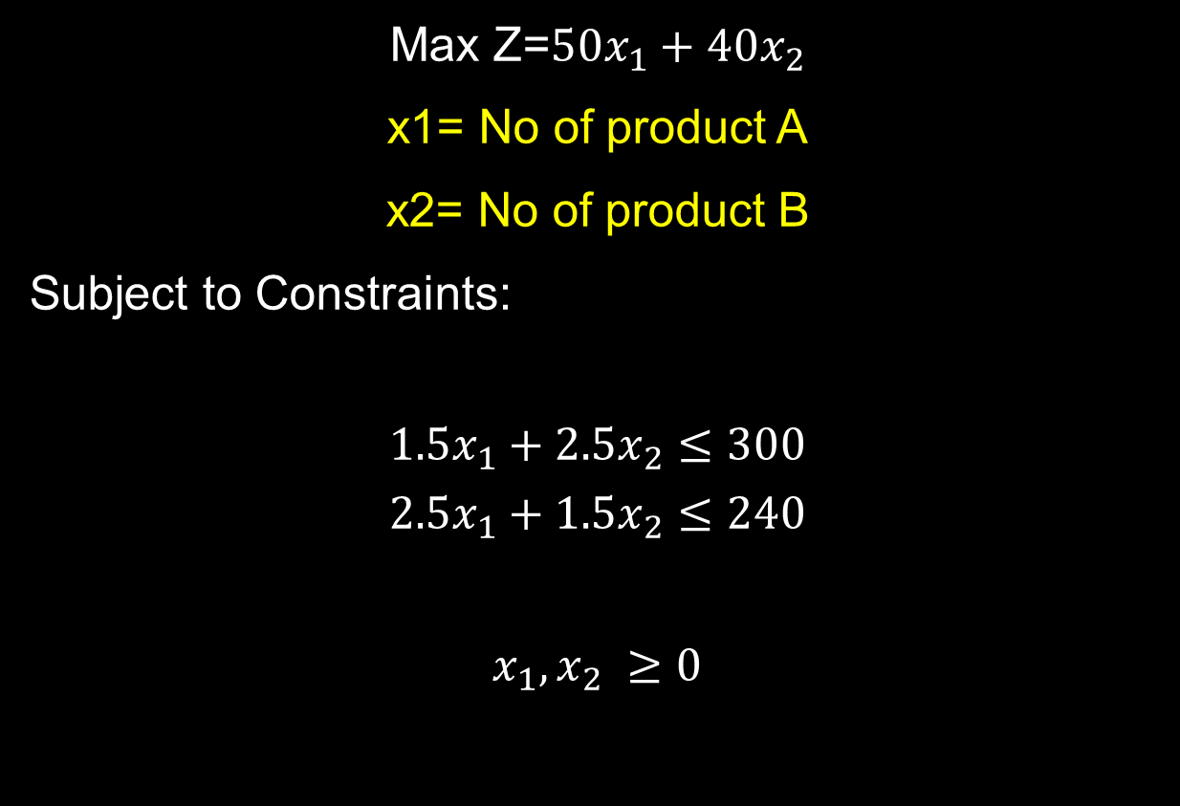
Formulation of linear programming in mathematical form
Max Z=$50x_{1}+40x_{2}$
x1= No of product A
x2= No of product B
Subject to Constraints:
$$1.5x_{1}+2.5x_{2}≤300$$
$$2.5x_{1}+1.5x_{2}≤240$$
$$x_{1},x_{2} ≥0$$

Slide 33
Solution of linear programming
Graphical method
Simplex method
Two phase simplex method
Big M method
Duality method

Slide 34
Thank you!

